Slide 1
Planned Giving
(for people who are new to planned giving)
Wayne Olson
Senior Director, Planned Giving
Shriners Children’s
wayne.olson@shrinenet.org
(256) 924-9223

Slide 2
Philosopher:
Montgomery Christopher
Jorgensen Scott

Slide 3
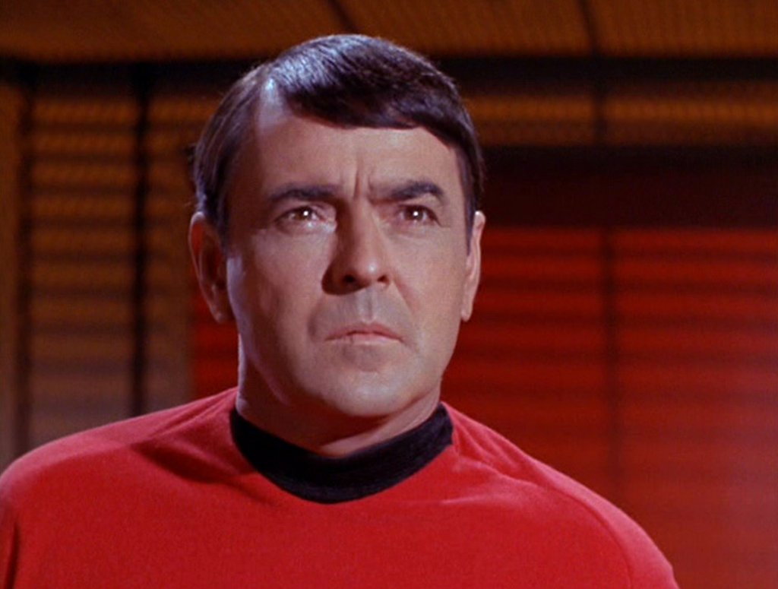
“The more they add to the plumbing, the easier it is to stop up the drain.”

Slide 4
Without Planned Giving, you may have more excitement, but you are missing an important part of the program.

Slide 5
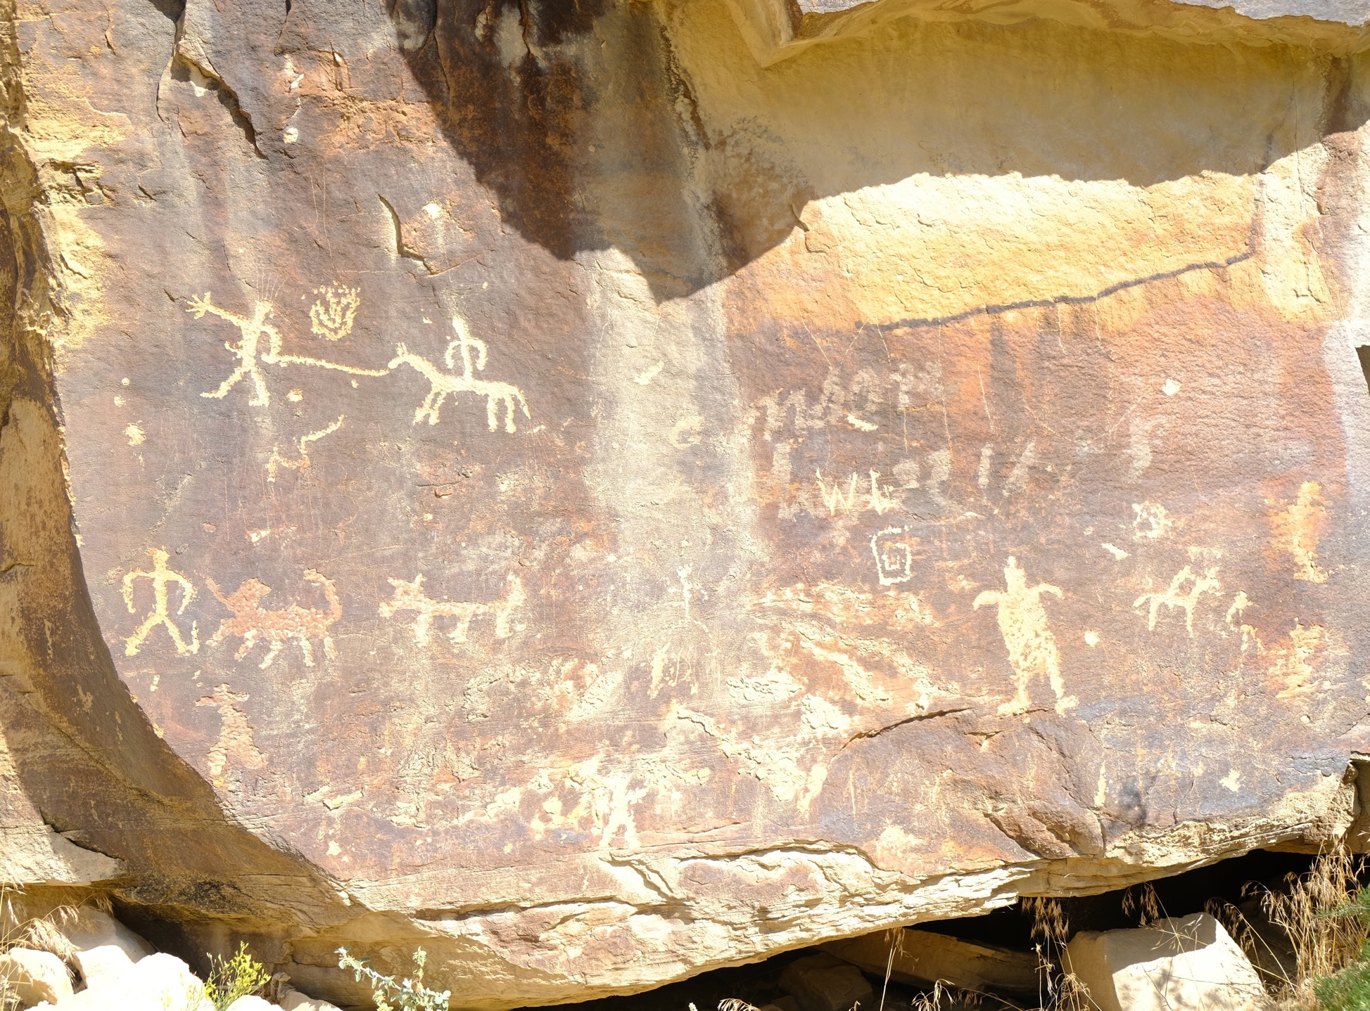

Slide 6
Donors Give to Sincere People more than they Give to Technical Specialists

Slide 7
Planned giving is the only way people can support a charity that brings them tremendous satisfaction, yet has no impact on their lifestyle, other than to improve it.
Wayne Olson

Slide 8
Planned Giving:
a gift that comes to an organization in a form other than cash, and often after an event, such as the death of the donor.
Or
any gift that takes more
than two minutes to form.

Slide 9
1. Why Planned Giving?
2. The Basics
3. Make it Work for You

Slide 10
2021 Nationally
Total Giving $484.85
(in billions)

Slide 11
Total U.S. Giving
4%
From 2020 to 2021

Slide 12
77 % of gifts come from individuals
Notes:
Not from corporations or foundations! But remember that foundations and corps are only clusters of individuals!

Slide 13
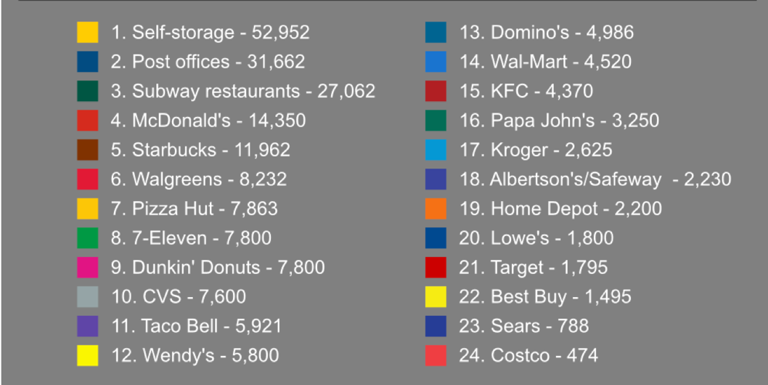
52,952
Self-storage facilities
Source: John Egan, squarefoot.com
Notes:
Post offices: 31,662 Subway restaurants: 27,062 McDonald’s restaurants: 14,350 Starbucks coffee shops: 11,962

Slide 14
36,450
health clubs and fitness centers in the U.S.
source: statista.com

Slide 15
The primary reason to make a gift to your organization over others is NEVER economic
Notes:
saying people give for the tax benefit is like saying people go to Starbucks only for the coffee.

Slide 16
We make decisions emotionally and justify them intellectually

Slide 17
Estimate: by 2055 $41 trillion will change hands as Americans pass assets to the next generation.
The 2010 Bank of America Study of High Net Worth Philanthropy conducted by the Center on Philanthropy at University of Indiana

Slide 18
62
Average age of charitable donor in the United States.
2016 Charitable Giving Report, Blackbaud Institute for Philanthropic Impact
Notes:
2016 Charitable Giving Report, Blackbaud Institute for Philanthropic Impact

Slide 19
Age 65 Birthdays
1995: 2,800 a day
2019: 10,000 a day
Charles Schultz, Crescendo Interactive

Slide 20
Three Goals
1. Why Planned Giving?
2. The Basics
3. Make it Work for You

Slide 21
Types of Assets
Planned Giving has two parts
Types of Vehicles

Slide 22
Common Assets
Types of Assets
Cash
Stock
Real Property
Life Insurance
IRAs
Types of Vehicles

Slide 23
Common Vehicles
Types of Assets
Wills
Trusts
Gift Annuities
Life Insurance
IRAs
Property
Types of Vehicles

Slide 24
Planned Giving often involves legal counsel

Slide 25
Donors mostly don’t want to know about the vehicles we use to get them to their goals.
They just want us tell them how wonderful the destination is – and how it is great for them.

Slide 26
26 U.S. Code § 501 - Exemption from tax on corporations, certain trusts, etc.
Exemption from taxation
An organization described in subsection (c)…shall be exempt from taxation under this subtitle…
(b) …
(c) List of exempt organizations
…
(3)Corporations, and any community chest, fund, or foundation, organized and operated exclusively for religious, charitable, scientific, testing for public safety, literary, or educational purposes, or to foster national or international amateur sports competition…

Slide 27
United States Taxes Income not Wealth

Slide 28
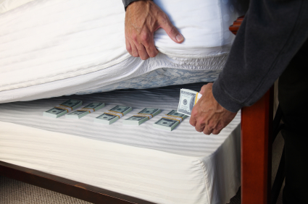
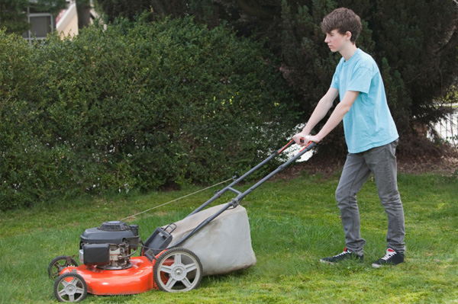
No Taxes
We tax the movement of money, not the holding of it.
Taxes

Slide 29
Whether you net worth is $5 or $5 million if you earned no money this year you owe no income taxes

Slide 30
Who said?
“With malice toward none, charity for all…”
Second Inaugural Address. March 4, 1865

Slide 31
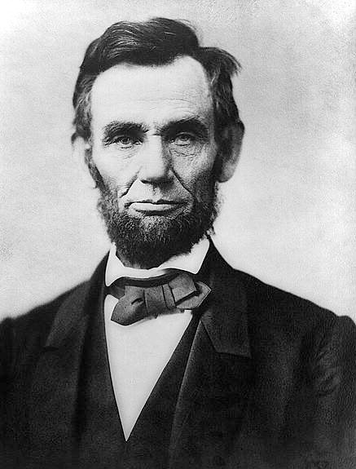
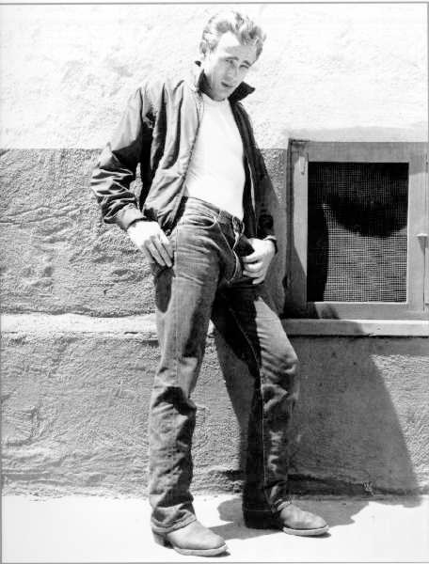
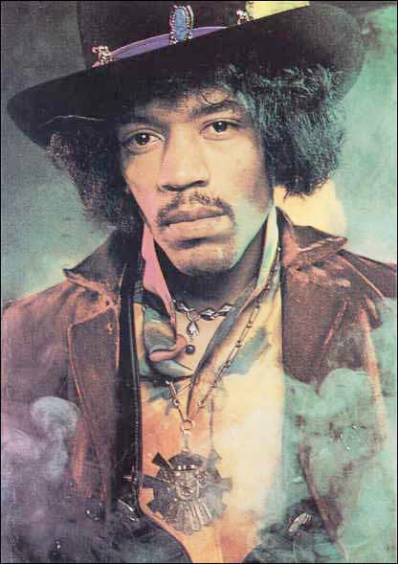
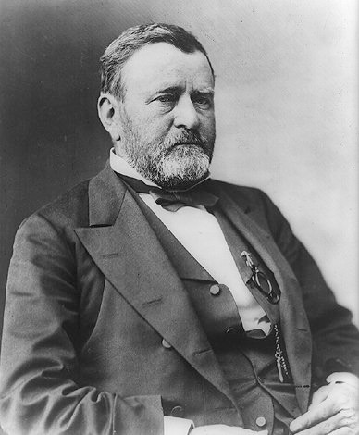
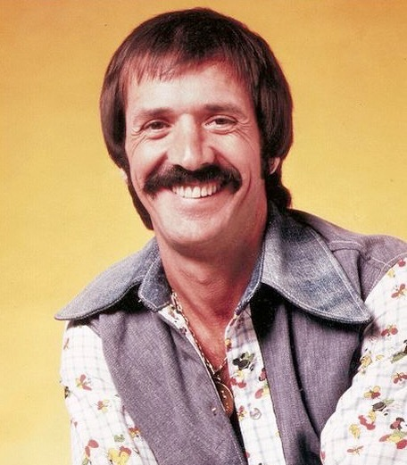
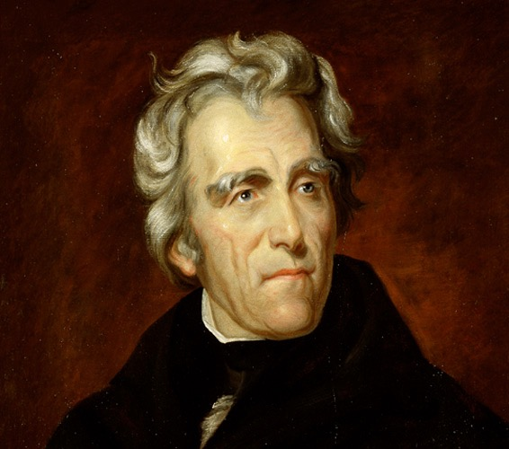
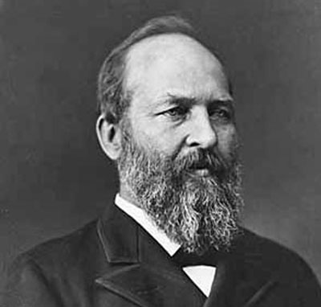
Notes:
james a garfield - 20th president - Major General from Ohio, Shiloh and Chickamauga
jim dean
sonny bono
Jimmy Hendrix

Slide 32
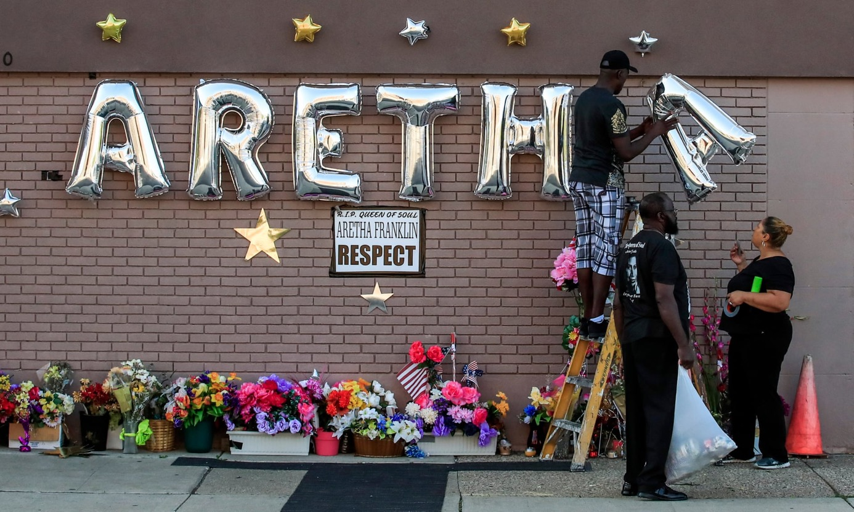
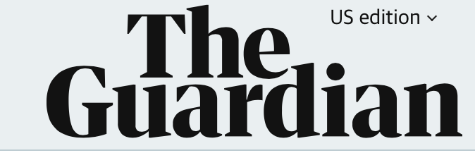
September 2, 2018
Aretha Franklin died without a will
Her four sons and other family members are left to find out how much the Queen of Soul was worth, and to divide it up
Notes:
Aretha Franklin died without a will. Aretha Franklin, who died Aug. 16 at 76 years old. Gwendolyn Quinn, Franklin’s representative, said the cause was pancreatic cancer.
Although the Queen of Soul’s worth was estimated to be approximately $80 million, she didn’t leave a will.

Slide 33
Wills

Slide 34
What is a will?

Slide 35
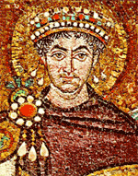
Justinian Code
Notes:
Under the Justinian Code in ancient Rome oral and written wills were recognized, but they had to be approved by a public official.

Slide 36
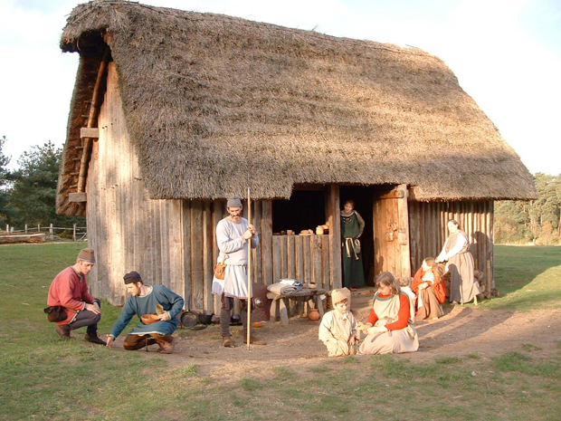
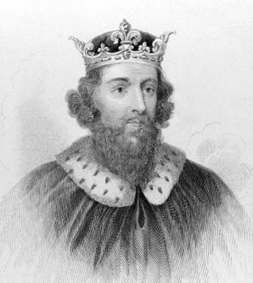
Not until I say so.
Someday, son this will all be yours
Anglo-Saxon England
Notes:
Transfers of Land were transfers of power and had to be approved by royalty. If no heirs, then property went to “Crown”

Slide 37
What about me?
Someday, oldest son this will all be yours
What about me?
What about me?
What about me?
What about me?
Thanks, Dad.
Primogeniture
Notes:
Transfers of Land were transfers of power and had to be approved by royalty. If no heirs, then property went to “Crown”

Slide 38
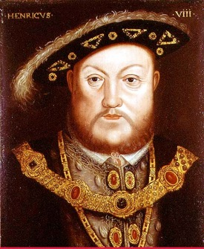
1540
Statute of Wills
Notes:
1540 - Statute of Wills - for the first time,

Slide 39
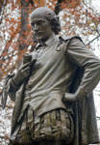
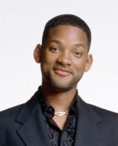
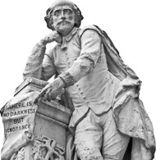
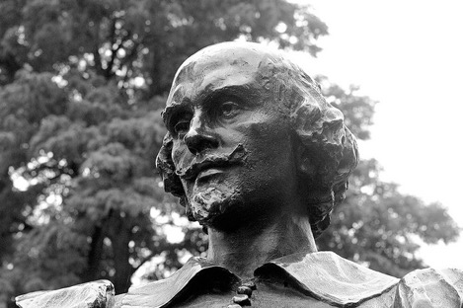
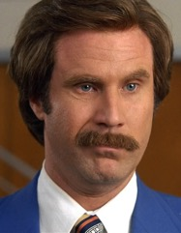
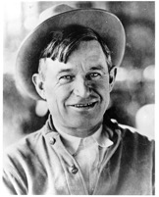
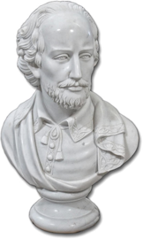
1540
Statute of Wills
Notes:
1540 - Statute of Wills

Slide 40
1540
Wills must be:
in writing
signed by writer
properly witnessed
Statute of Wills
Notes:
1540 - Statute of Wills - for the first time, landowners could pass property to who they wanted.
AND certain requirements made their way into custom that we follow today. The idea is to make sure the will is genuine and that the testator’s will is followed.

Slide 41
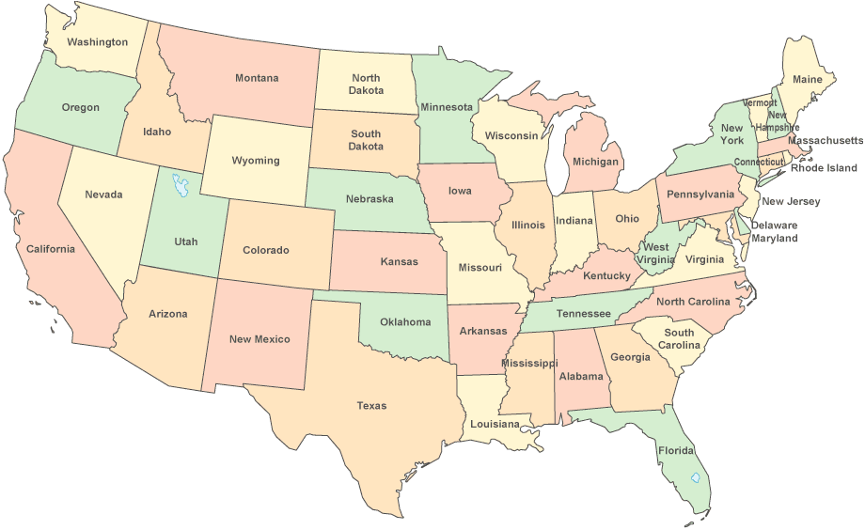
Notes:
In our country, state law determines who inherits what.

Slide 42
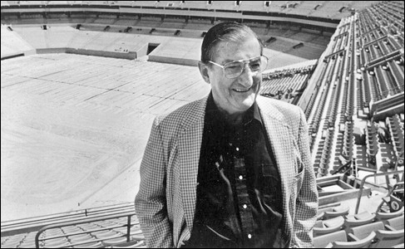
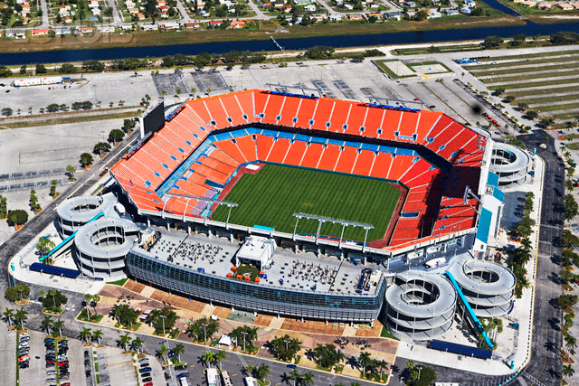
$47 million
estate tax bill
Notes:
Awarded franchise in 1965. Robbie died in 1990. Family had to sell stadium and team for $138 million to pay taxes. Family no longer owns. Team worth much more now.

Slide 43
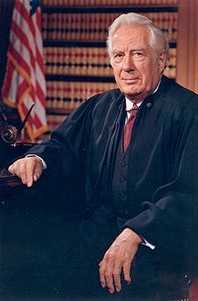
Supreme Court Justice Warren Burger
LAST WILL AND TESTAMENT OF WARREN E. BURGER
I hereby make and declare the following to be my last will and testament.
1. My executors will first pay all claims against my estate;
2. The remainder of my estate will be distributed as follows: one- third to my daughter, Margaret Elizabeth Burger Rose and two- thirds to my son, Wade A. Burger;
3. I designate and appoint as executors of this will, Wade A. Burger and J. Michael Luttig.
IN WITNESS WHEREOF, I have hereunto set my hand to this my Last Will and Testament this 9th day of June, 1994.
/s/Warren E. Burger
We hereby certify that in our presence on the date written above WARREN E. BURGER signed the foregoing instrument and declared it to be his Last Will and Testament and that at this request in his presence and in the presence of each other we have signed our names below as witnesses.
/s/Nathaniel E. Brady residing at 120 F St., NW, Washington, DC
/s/Alice M. Khu residing at 3041 Meeting St., Falls Church, VA
Notes:
Hand-typed on his pc. Had some typos and failed to give executors power to do simple things like sell property. Result: increased, unnecessary probate costs.

Slide 44
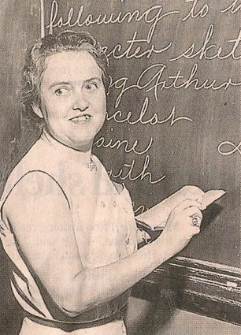
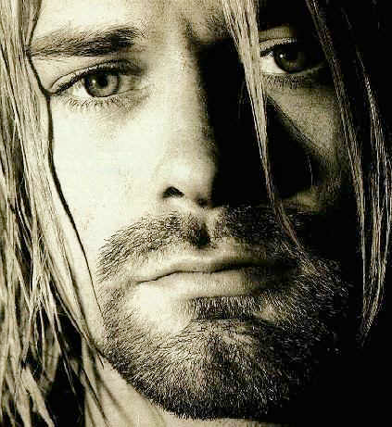
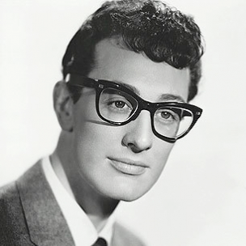
Which of these people left $2 million to charity in his or her will?
Kurt Cobain
Buddy Holly
Jane Crutchfield
Notes:
Kurt Cobain, Buddy Holly and a retired schoolteacher.
Teacher left 2.2 million in her will. Cobain and Holly died without a will.
Holly’s plane: American Pie.

Slide 45
Kurt Cobain and Buddy Holly died without a will.
No gifts.
Plenty of Hassle.
Notes:
Kurt Cobain, Buddy Holly and a retired schoolteacher.
Teacher left 2.2 million in her will. Cobain and Holly died without a will.
Holly’s plane: American Pie.

Slide 46
Wills
Only 2% are revoked
2/3rds of bequest donors make annual fund gifts
Source: Crescendo Interactive, Charles Schultz and Katherine Swank Target Analytics

Slide 47
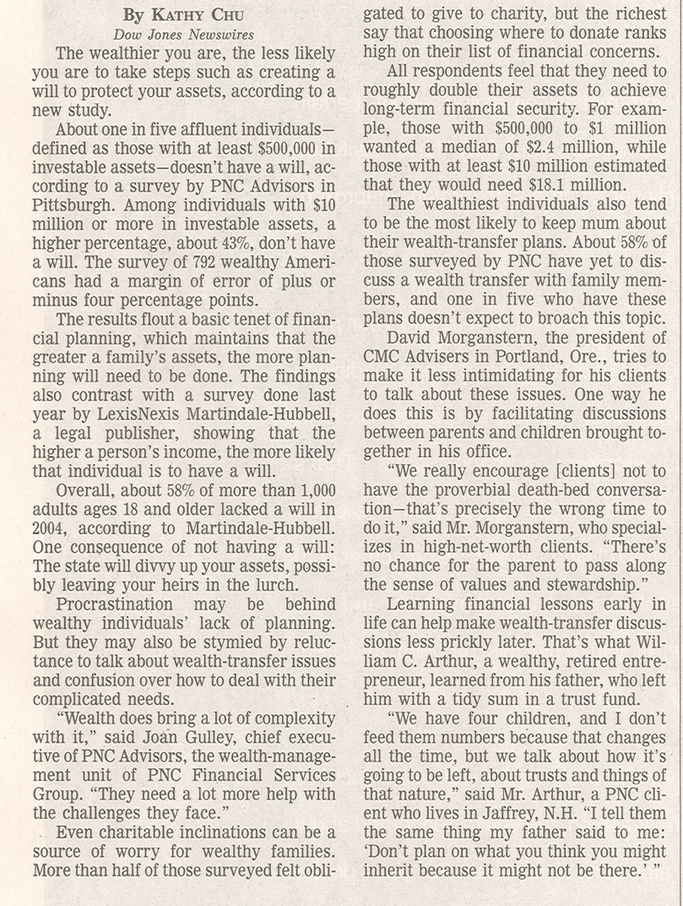
58% of those 18 and over have no will (written by them).

Slide 48
43% of those with $10 million or more have no will.

Slide 49
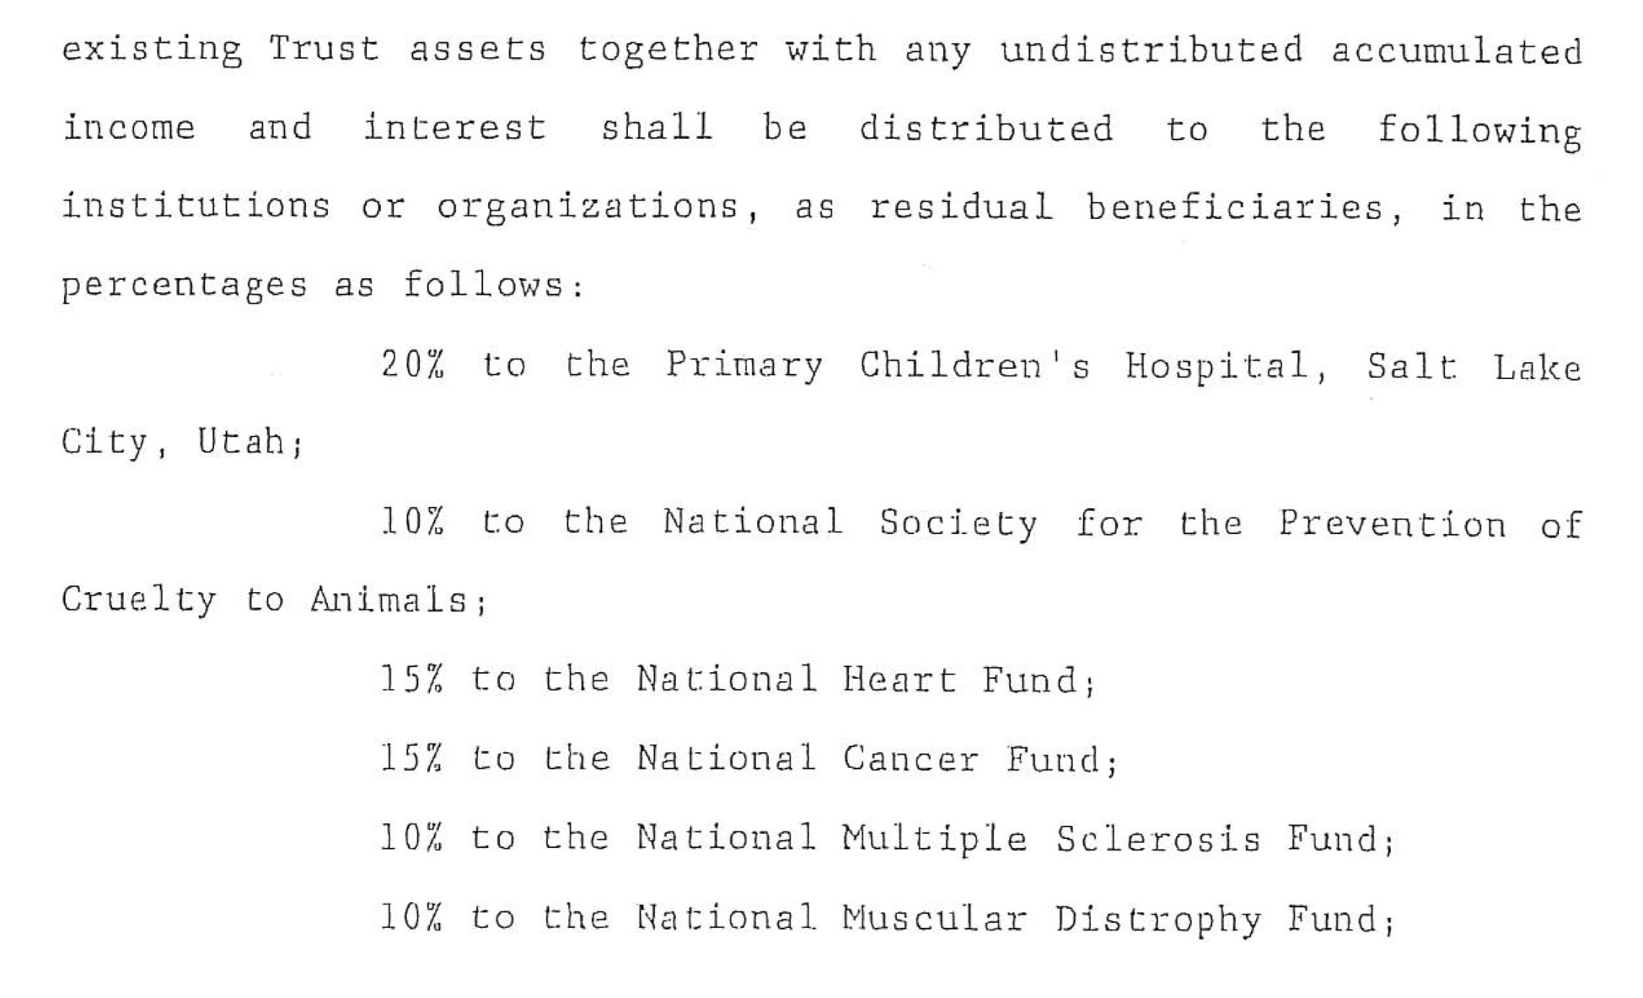
$16,000
$8,000
$12,000
$12,000
$8,000
$8,000

Slide 50
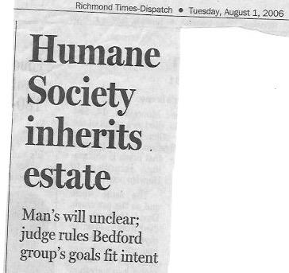
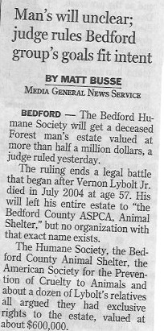
$600,000 Estate of Vernon Lybolt, Jr.

Slide 51
$600,000 Estate of Vernon Lybolt, Jr.
Left money to the “the Bedford County ASPCA, Animal Shelter”
Judge ordered the Bedford County Humane Society to build a shelter.

Slide 52
Give donors will language

Slide 53
Wills
88%-90% of all donors who give $500 per year over age 50 will die without a charitable estate plan.
Russell James, J.D., Ph.D.
Texas Tech

Slide 54
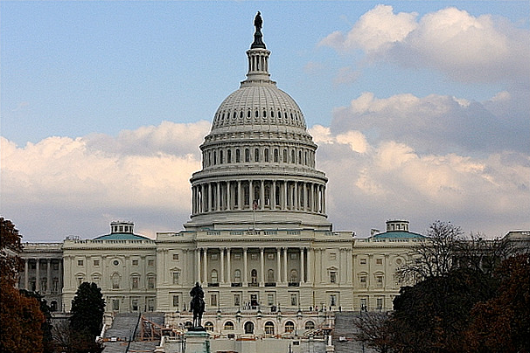
Pick Two
Notes:
Taxes when you die

Slide 55
What do Charities Really Say About Bequests?

Slide 56
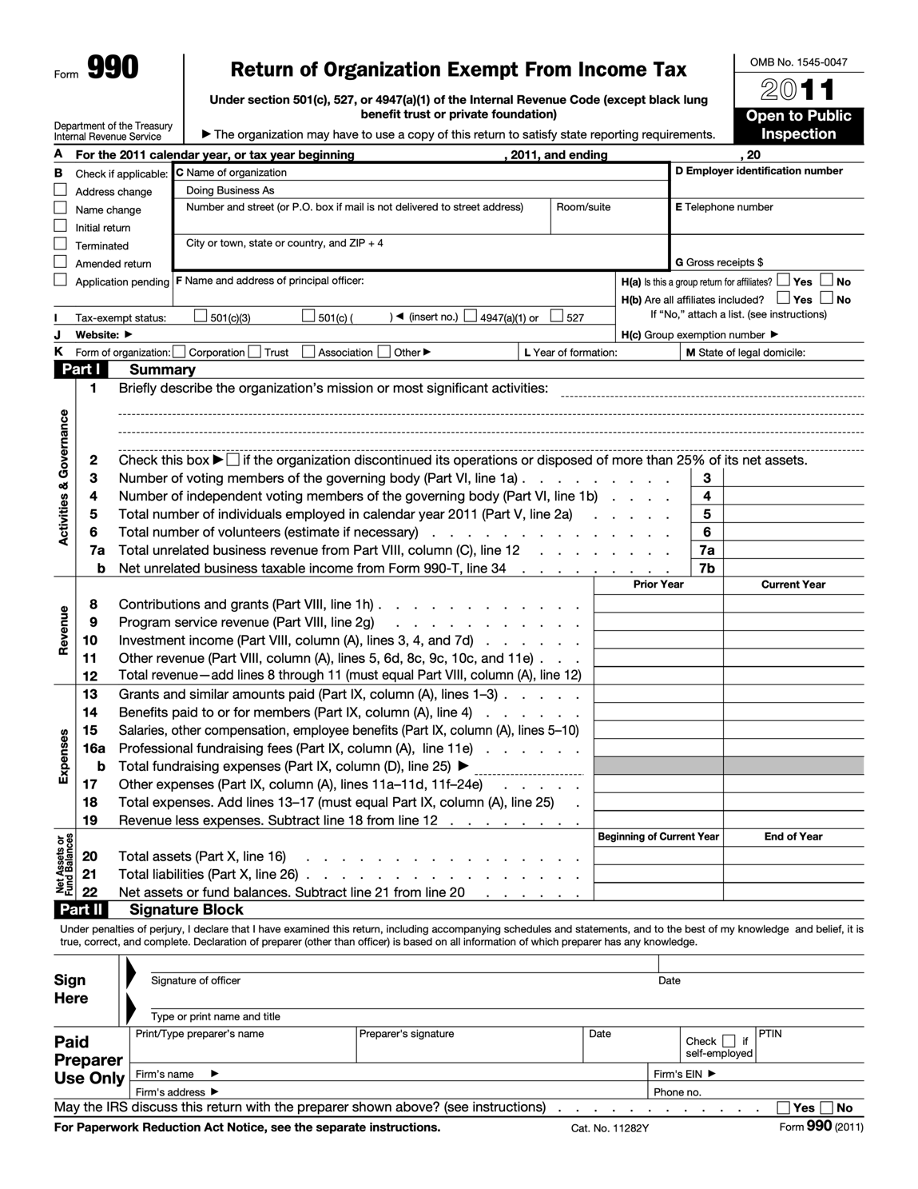

Slide 57
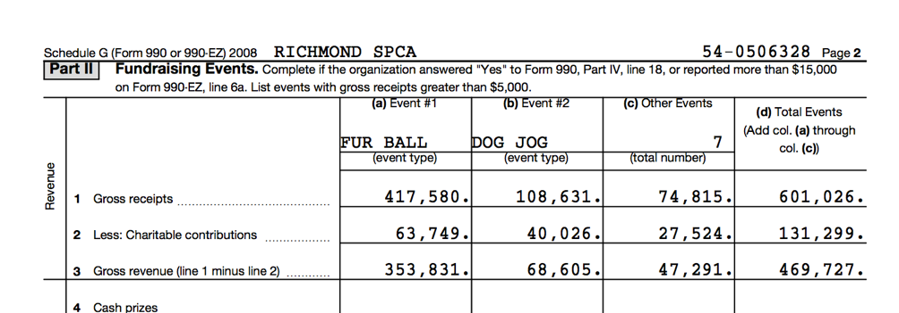

Slide 58
A real charity’s fundraising events in one year*
Nine annual events
(a ball, a run and 7 “other” events)
Gross Revenue | $469,727
Expenses | $102,981
Total | $354,579
Note: this includes only direct expenses and revenue
*Form 990, Schedule G, 2008
Notes:
This from the Richmond SPCA Form 990 for tax year 2008

Slide 59
Other Costs?
CEO ($189,008
Dev. Staff
CFO
Volunteers
Mail
Other?
Opportunity Cost (donations went to events rather than mission)
Notes:
That same year, the organization received a house in a bequest they sold for $727,846.
This organization has no planned giving officer by title on staff

Slide 61
Special Events
One Planned Gift
$354,579
$727,846
Notes:
That same year, the organization received a house in a bequest they sold for $727,846.
This organization has no planned giving officer by title on staff

Slide 62
Trusts
(common and charitable)

Slide 63
Trusts
Dozens of Varieties
Trust is invested (and hopefully grows)
Can hold many types of assets
Provides some legal protections
Usually avoids probate
Charitable trusts irrevocable, but have extra benefits

Slide 64
Trusts
Standard (non-charitable)Trusts
Infinite varieties
Helpful for holding assets
Part of a strategic tax plan
As many uses as there are people
Can be amended without formalities of a will
Can include charity in the trust
Talk with your attorney to see what a trust can do for you.

Slide 65
Trusts
Charitable Trusts
Almost all the advantages of standard trusts
Provides payments to you for life, or
Lasts for a term of years
Provides significant tax advantages
Is irrevocable
Talk with your attorney to see what a trust can do for you.

Slide 66
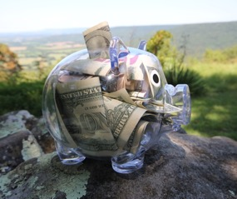
During Life
End of Trust
Charitable Remainder Unitrust

Slide 67
Pay on Death Gifts

Slide 68
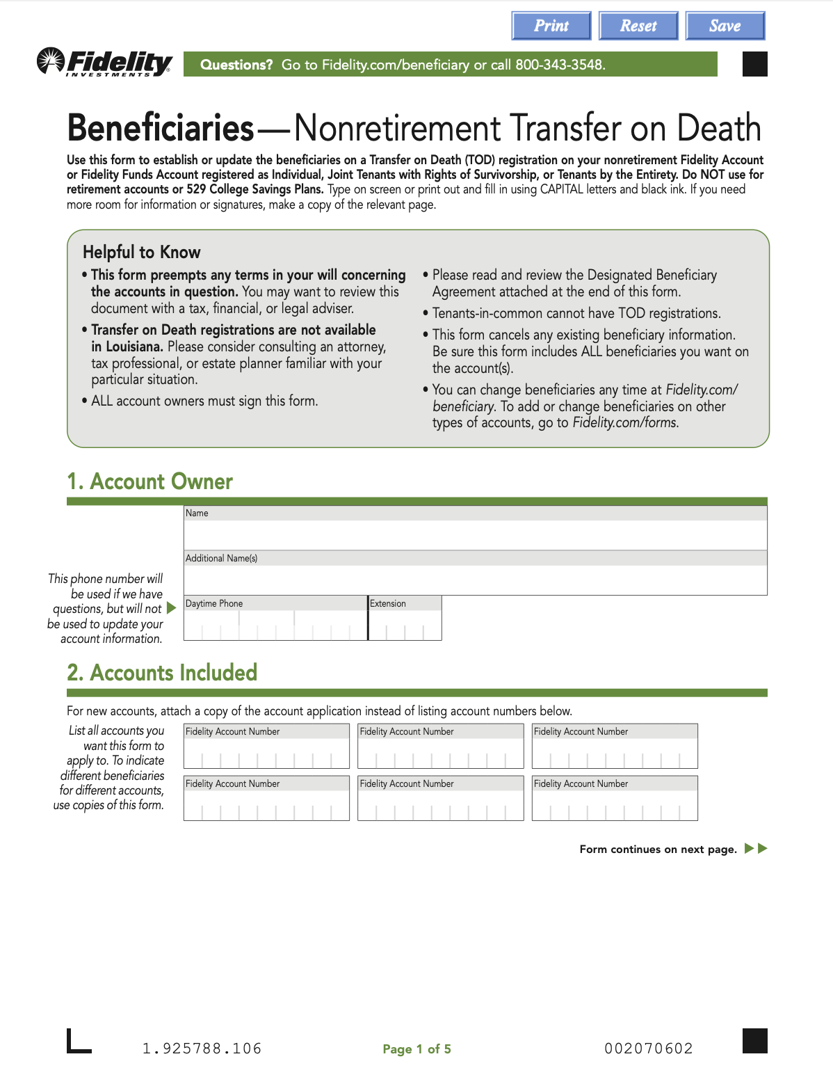
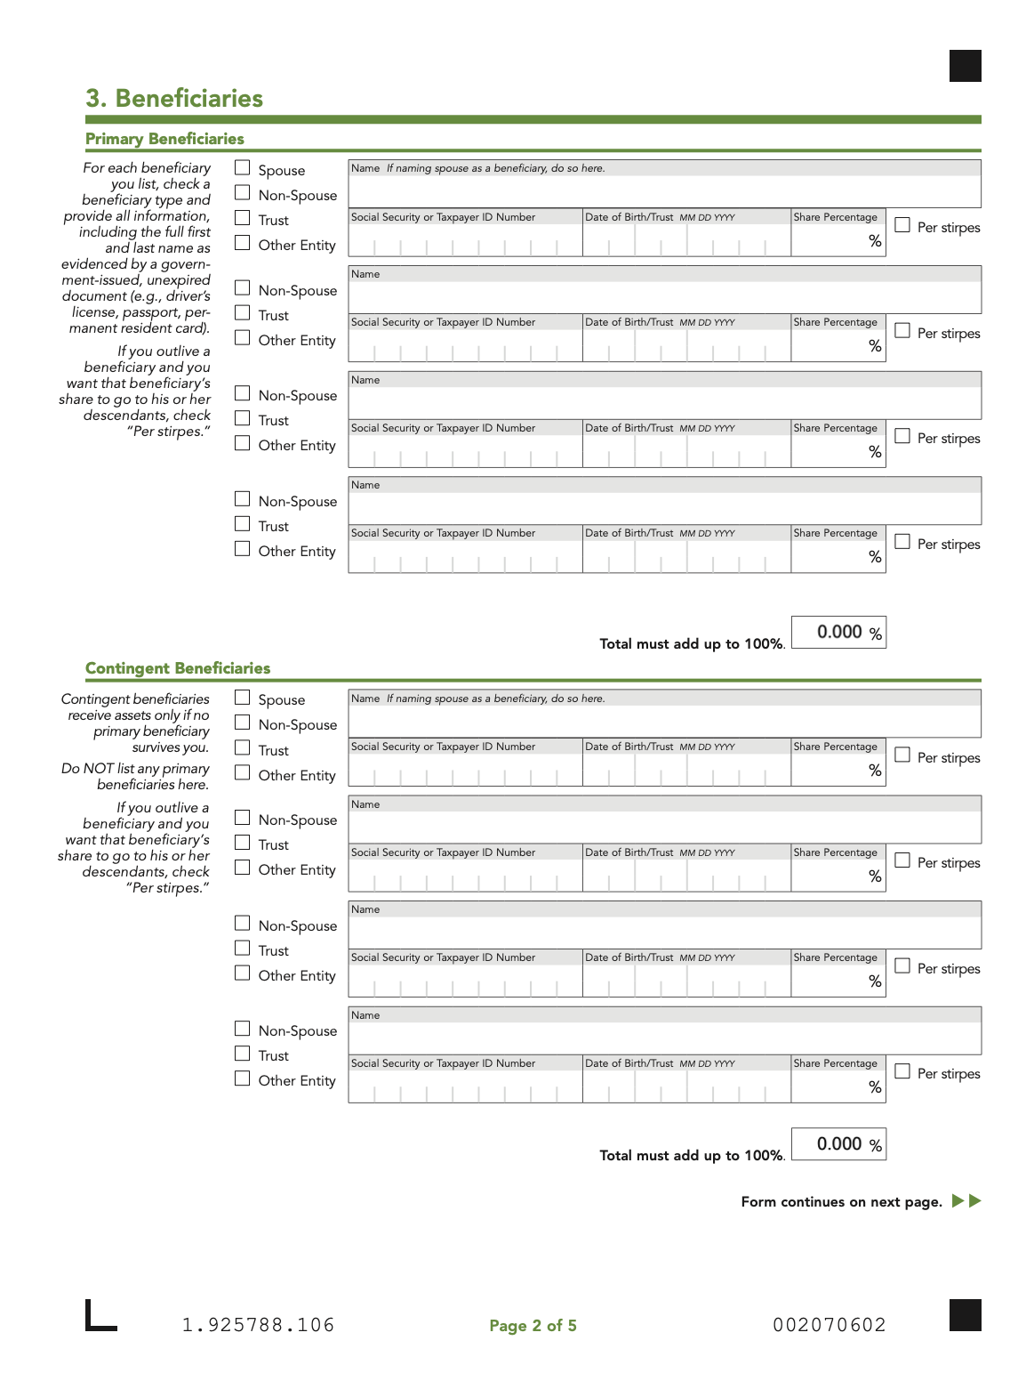

Slide 69
Stock Gifts

Slide 70
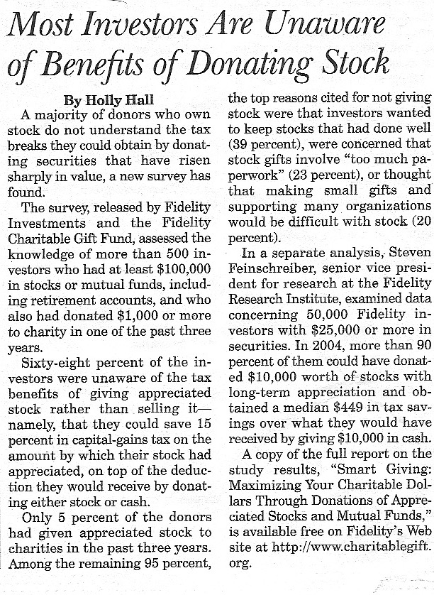
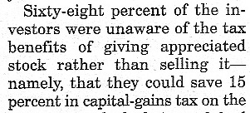
We have work to do!
You are needed!
Notes:
Just remind donors two or three times a year they can donate by stock.
Stocks have reached a recent new high. Maybe they want to cash out?

Slide 71
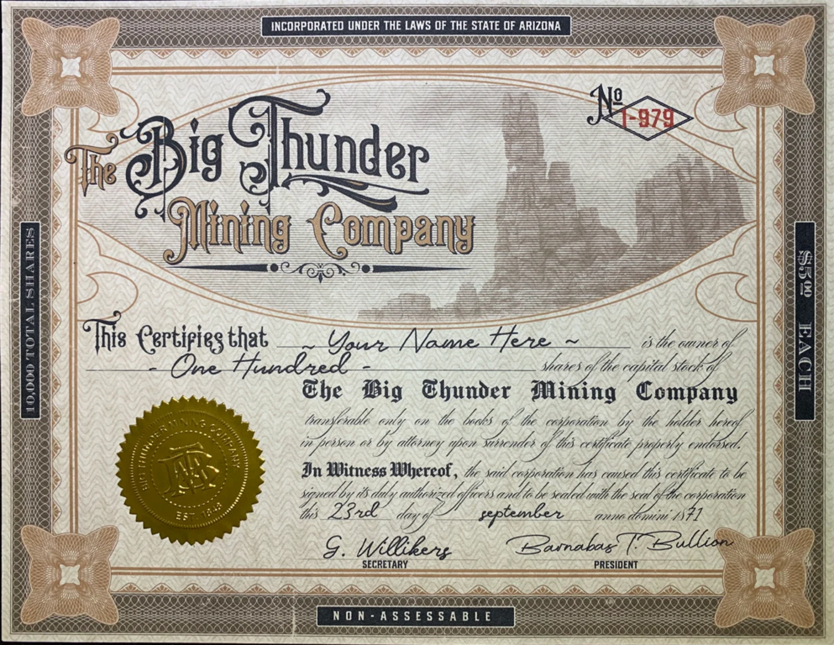
Donor Sells Stock
Purchase Price | $1 | 2004
Current Value | $100 | 2023
Gain | $99 | 0
23.8% Tax Bracket | $23.56 TAX | 0
Donor Keeps | $76.44 | 0
Donor Transfers Stock
Donor transfers stock.
Charity receives stock worth $100
Charity sells stock, gets $100
Donor pays no capital gains tax
Donor receives $100 income tax deduction

Slide 72
Charitable Gift Annuity

Slide 73
It is a Contract

Slide 74
It is not Insurance

Slide 75
Only Nonprofits can Issue Gift Annuities

Slide 76
Agreement is Irrevocable

Slide 77
Donor Gives Charity an Asset

Slide 78
Charity Pays Donor for LIFE at Fixed Rates

Slide 79
After Lifetime of Payments, Remainder Supports Charity

Slide 80
Appreciated Assets have Extra Benefits

Slide 81
Benefits
Regular Payments
Income Tax Deduction
Capital Gains Benefits

Slide 82
Payments are Partially:
Income
Tax-Free
Capital Gains

Slide 83
Gift annuities can be:
One person
Two people

Slide 84
Gift annuities can be:
For people other than donor

Slide 85
Gift Annuity Payment Rates
70
5.9%
76
6.8%
71
6.0%
7.0%
77
72
6.2%
78
7.2%
73
6.3%
79
7.4%
74
6.4%
80
7.8%
75
6.6%
81
7.8%
Effective January 1, 2023

Slide 86
Gift Annuity Payment Rates
82
8.1%
88
9.3%
83
8.3%
9.5%
89
84
8.5%
90+
9.7%
85
8.7%
86
8.9%
87
9.1%
Effective January 1, 2023

Slide 87
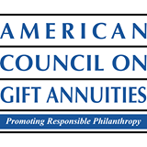
2013 Survey of Charitable Gift Annuities
44%-49% of gift annuities come from donors who already have one.

Slide 88
Gift Annuity Facts
The average gift is $59,000

Slide 89
Gift Annuity Facts
The average age at funding is 79

Slide 90
Life Insurance

Slide 91
Real Property

Slide 92
Personal Property

Slide 93
IRA Gifts

Slide 94
Things to Know
The average American has $119,804 in his or her IRA
Americans have $2.46 trillion in IRA accounts
Top 12% of us have more than $250,000 in IRAs
53% of us max out our annual contribution to IRAs
(May 29, 2015)

Slide 95
Three Goals
1. Why Planned Giving?
2. The Basics
3. Make it Work for You

Slide 96
Olson’s Law on Giving
A Donor Will always Give when the Emotional Satisfaction of Giving an Asset is Greater than the Comfort of Keeping it.

Slide 97
Try This:
Let your donors know you accept planned gifts, especially wills.

Slide 98
Try This:
Planned giving donors think differently. Start thinking like them.

Slide 99
Try This:
Mention bequest giving in your emails, newsletters and conversations.

Slide 100
Try This:
Develop and publicize your will language.

Slide 101
Try This:
Develop a network of friends and advisors to guide you.

Slide 102
Try This:
Mention planned giving on your website.

Slide 103
Try This:
Ensure your database tracks planned gifts.

Slide 104
Try This:
Have planned gift presence at all events.

Slide 105
Try This:
Include bequest option in annual fund outreach.

Slide 106
Try This:
Mention planned gifts at staff and board meetings.

Slide 107
Try This:
Celebrate and publicize all incoming planned gifts and planned gift intentions.

Slide 108
Try This:
Thank your planned giving donors.

Slide 109
Wayne,
Jack & Jill get an F for fundraising. We get routine updates from [other charity] to whom we give one-twentieth this amount. 😣. I expect, within the year, we’ll change our wills to eliminate [beloved charity]. How unfortunate. 😢

Slide 110
Any missing words?
TH_ N K YO_?

Slide 111
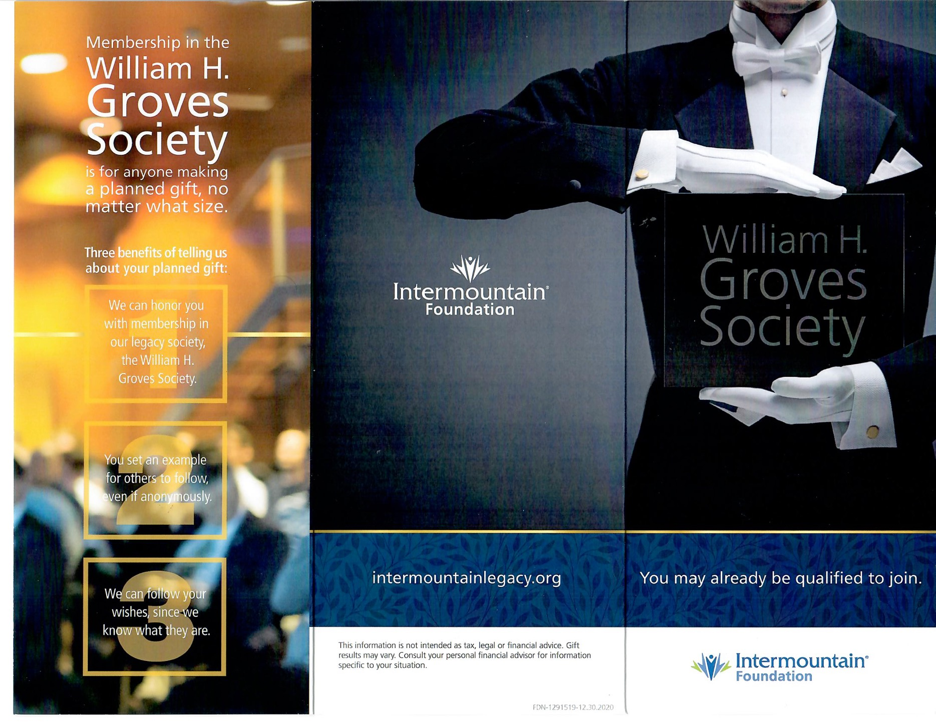

Slide 112
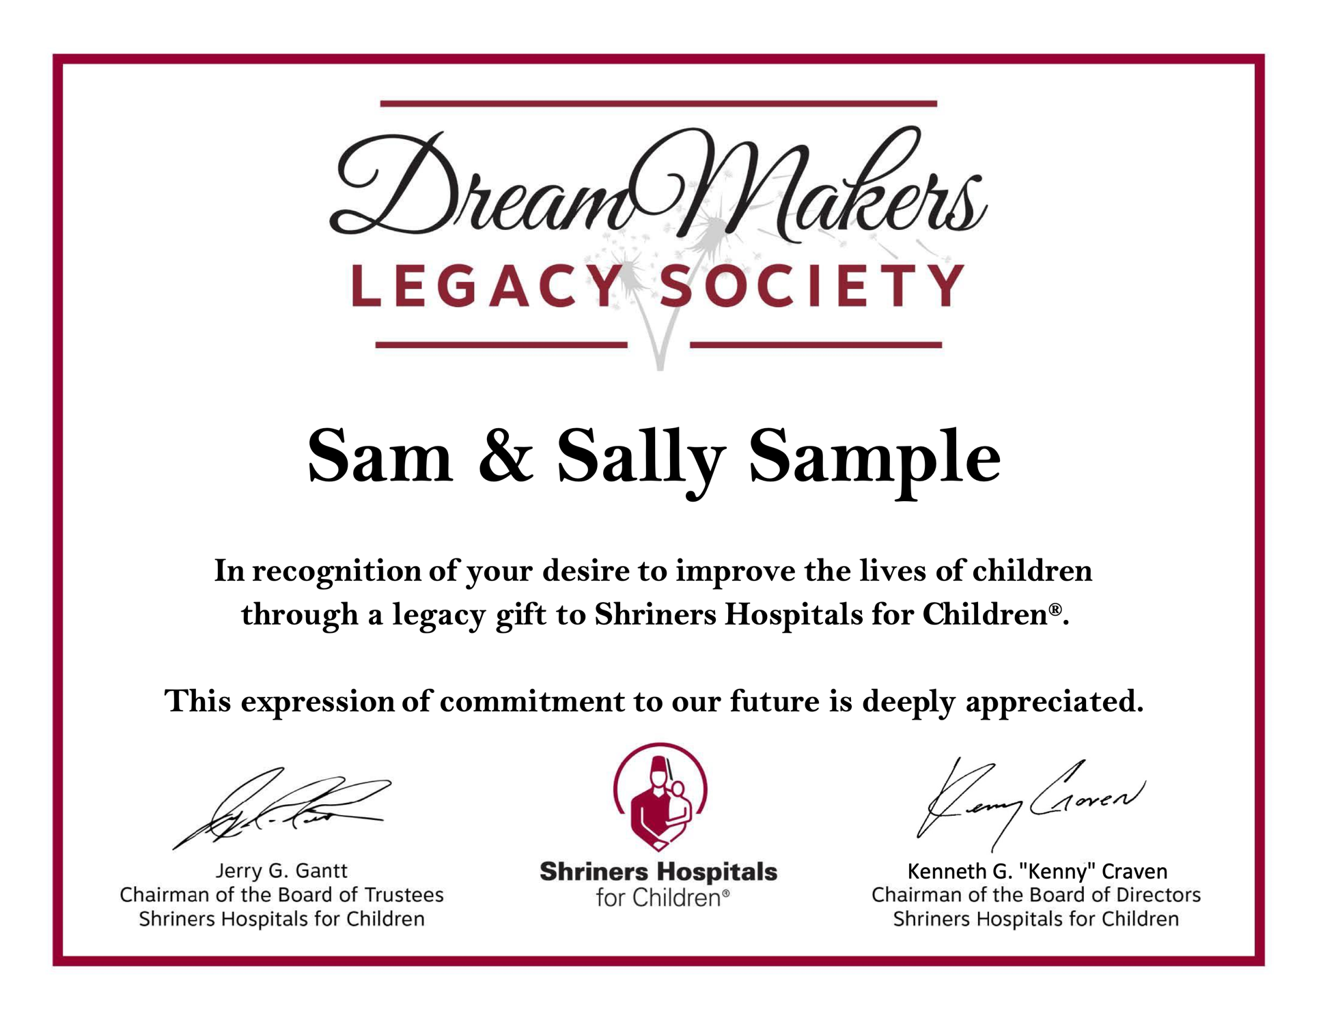

Slide 113
With a Little Momentum do This:

Slide 114
Try This:
Develop a planned giving page on your website.
Include forms of will language.
Include a couple basic types of gifts.

Slide 115
Try This:
Celebrate and publicize all incoming planned gifts and planned gift intentions.

Slide 116
Try This:
Create planned giving emails and postcards.

Slide 119
Feel Confident? Do This:

Slide 120
Try This:
Start looking for planned giving donors.

Slide 122
Words Never Heard
“Your brochure was so beautiful, I just had to whip out my checkbook.”

Slide 123
Reaching Out
Ask questions that begin with “who, what, when, where and why?”
Notes:
Focus on the good feelings. tax benefits. control. payments from annuity or trust. Don’t spend time on charity’s benefits.

Slide 124
Success Steps
Listen for “My IRA is over-funded, but I hate to take money out of it.”

Slide 125
Success Steps
Listen for “I want to make a difference.”

Slide 126
Success Steps
Listen for “I pay too much in taxes.”

Slide 127
Success Steps
Listen for “CD rates are horrible.”

Slide 128
Success Steps
Listen for “I wish I could do more.”

Slide 129
Success Steps
Listen for “My investments aren’t what they should be.”

Slide 130
Reaching Out
Real starting place: Make a gift ourselves.
Notes:
Focus on the good feelings. tax benefits. control. payments from annuity or trust. Don’t spend time on charity’s benefits.

Slide 131
Reaching Out
Thank Donors!
Notes:
Focus on the good feelings. tax benefits. control. payments from annuity or trust. Don’t spend time on charity’s benefits.

Slide 132
Don’t go alone.
Notes:
Focus on the good feelings. tax benefits. control. payments from annuity or trust. Don’t spend time on charity’s benefits.

Slide 133
Even the lone ranger is never alone.

Slide 134
Questions?
wayne.olson@shrinenet.org
wayne@wayneolson.com
www.wayneolson.com
@waynero

Slide 135
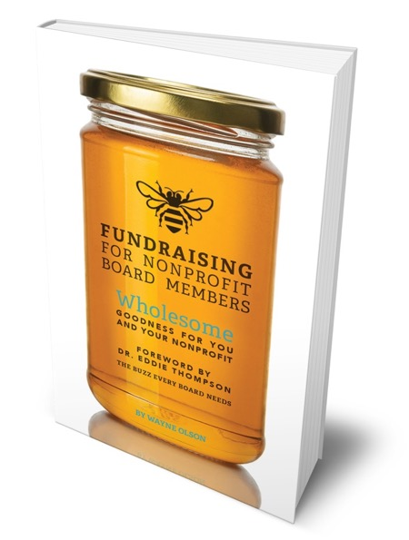
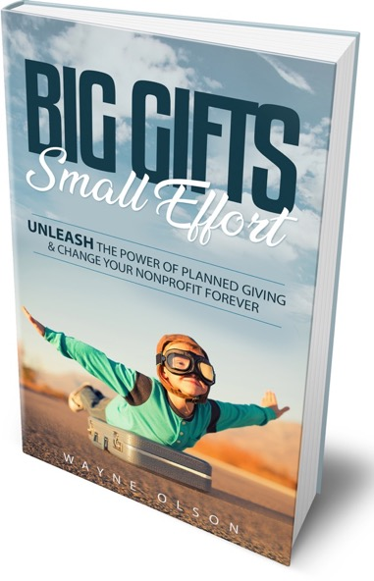
Thank you
Wayne Olson
Chief Development Officer
wayne@wayneolson.com
@waynero
(256) 924-9223 cell
(469) 272-6479 direct line

